Slide 1


Slide 2


Professional seminar organizer
Let’s Discuss Our
BUSINESS
PLAN
First Meet-up
2018

Slide 3
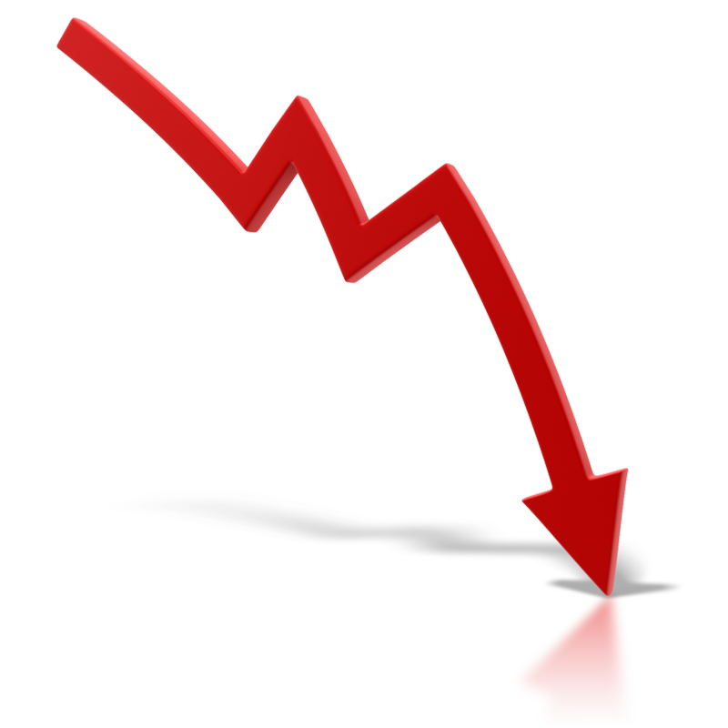


Small Introduction
BUSINESS PLAN – Vulcanix – Professional seminar organizer
A major plague for companies : disengaged workers
Incentives : a well-settled Market still increasing

Slide 4
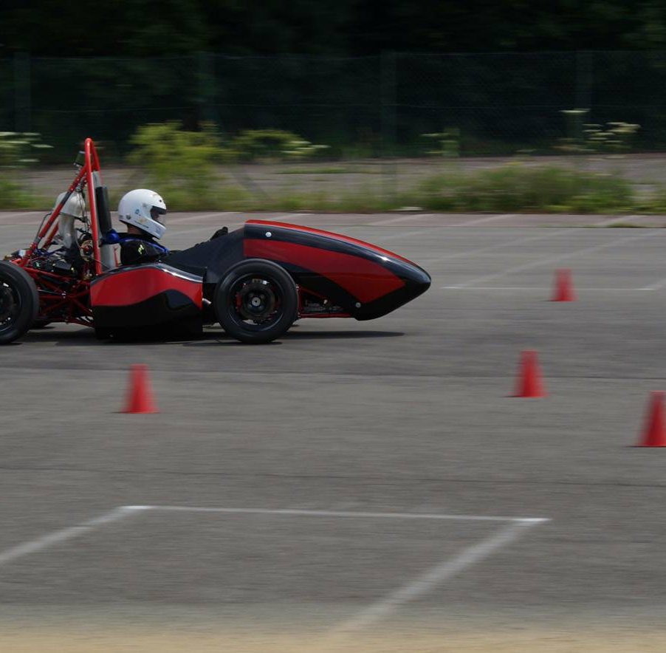




Presentation : Agenda
Market Analysis
State of the current market : threats and opportunities
Our service
An innovative way of teambuilding has to be implemented
How will we reach our objectives ?
Strategy
Financial Plan
A strong potential and a bright future
Professional seminar organizer
Notes:
Recadrer la photo

Slide 5

5
Market Analysis
State of the current market :
Opportunities and threats

Slide 6
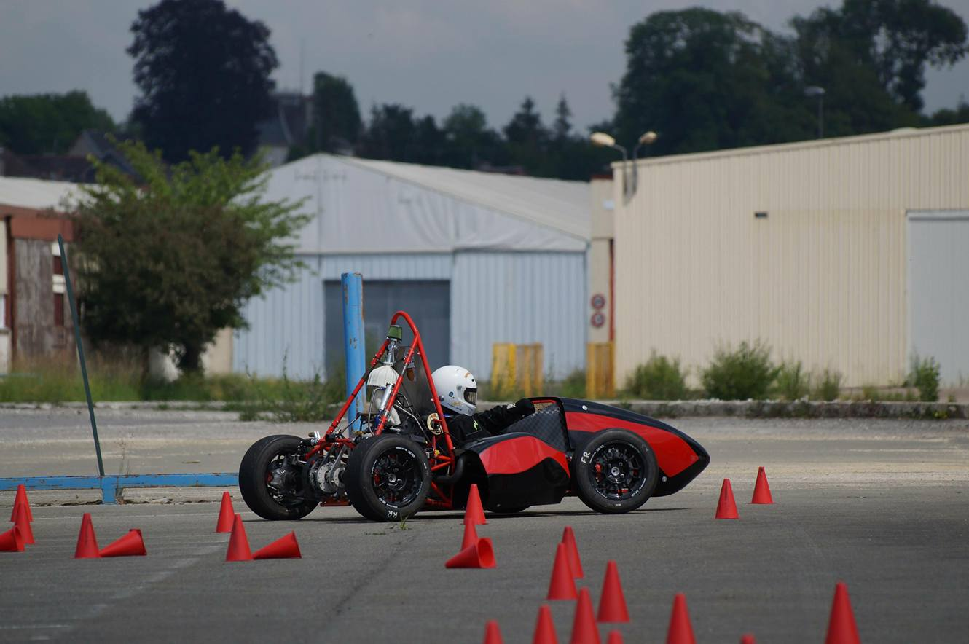
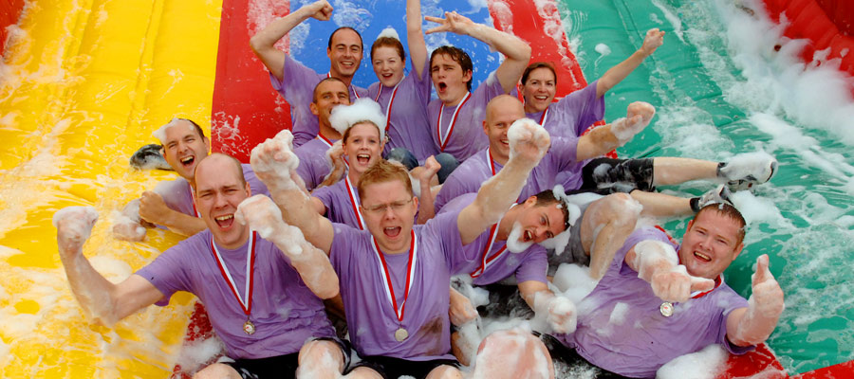
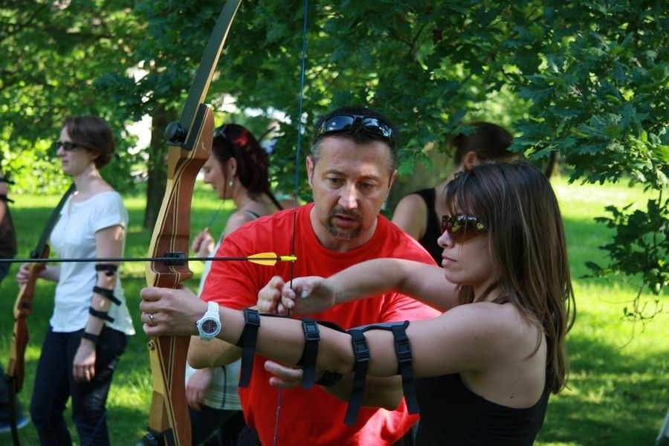

Market Analysis
Sensations
Use your hands
Use your brain
Notes:
Mettre une photo d’une équipe soudée autour du véhicule

Slide 7
Market Analysis
External analysis (1)
€2.2 BILLION
Seminars Market Potential
in France
Team Building Market Growth
+1,3% - 2016
Notes:
Le SWOT est nulachier, à approfondir !

Slide 8
SWOT Analysis
External analysis (1)
Internal


Positive
O
Negative
T
Opportunities
Threats
Global increasing tendency
A huge network of companies and partners
Innovation potential
No barrier to market entry of competitors
External
Notes:
Le SWOT est nulachier, à approfondir !

Slide 9
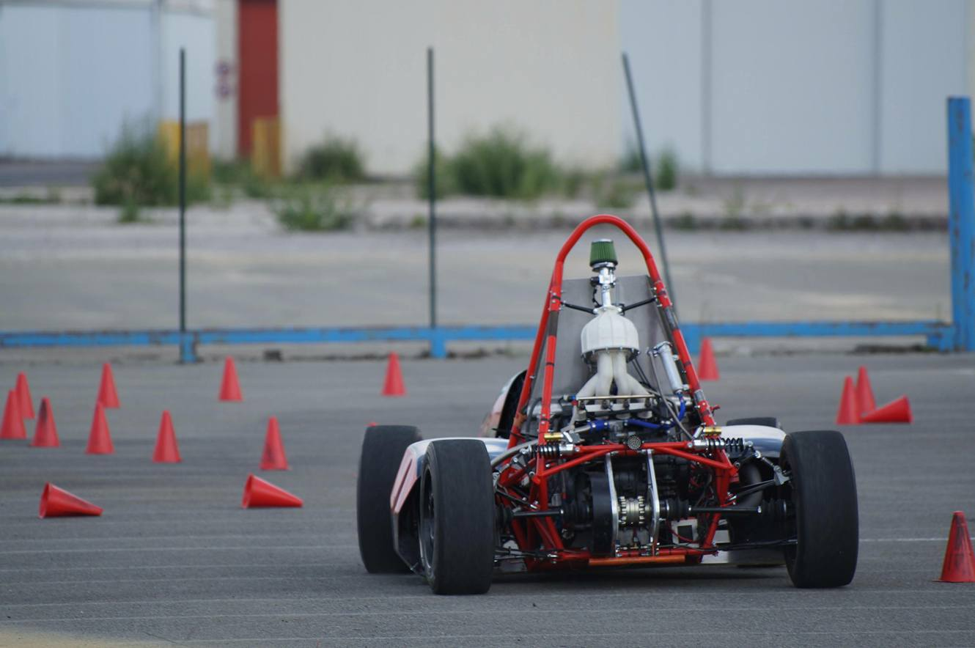

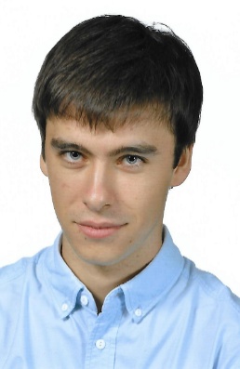
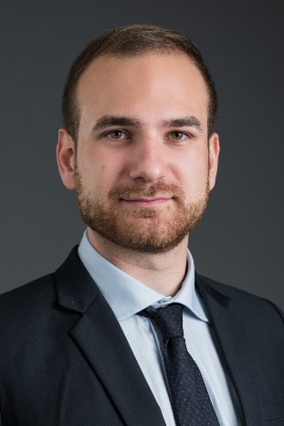


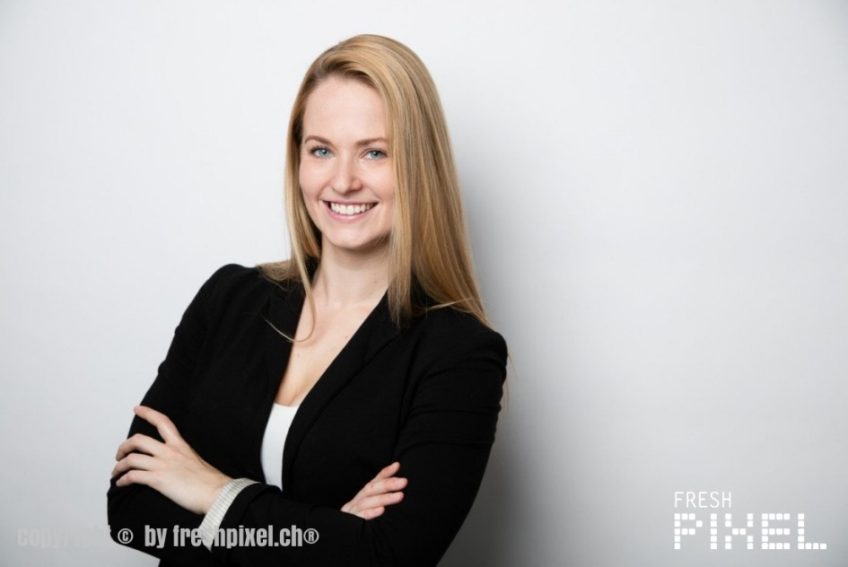
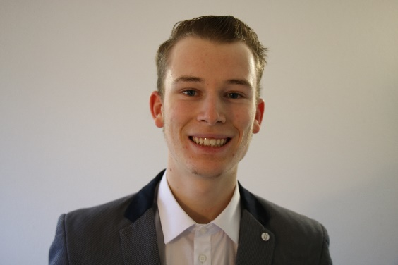



OUR SERVICE
12-25 candidates, 3 days
1 reliable and diverse team
Teamwork
More than 1000 potential vehicles to build
Car driving on professional race track
Original
Tactical
Technical
Fun

Slide 10






Our Service
10
Typical seminar schedule
1
2
3
Create your Specification note
Target your system
Work as a team
6
5
4
Work healthily and efficiently
Drive
Assemble

Slide 11
SWOT Analysis
Internal and External Analysis (2)
Strengths
Internal
Weaknesses
Original concept
High engineering background
Teamwork-oriented
S
Low brand recognition
Environmental issues
W
Positive
Negative
Opportunities
O
T
Threats
Global increasing tendancy
A huge network of companies and partners
Innovation potential
No barrier to market entry of competitors
External

Slide 12
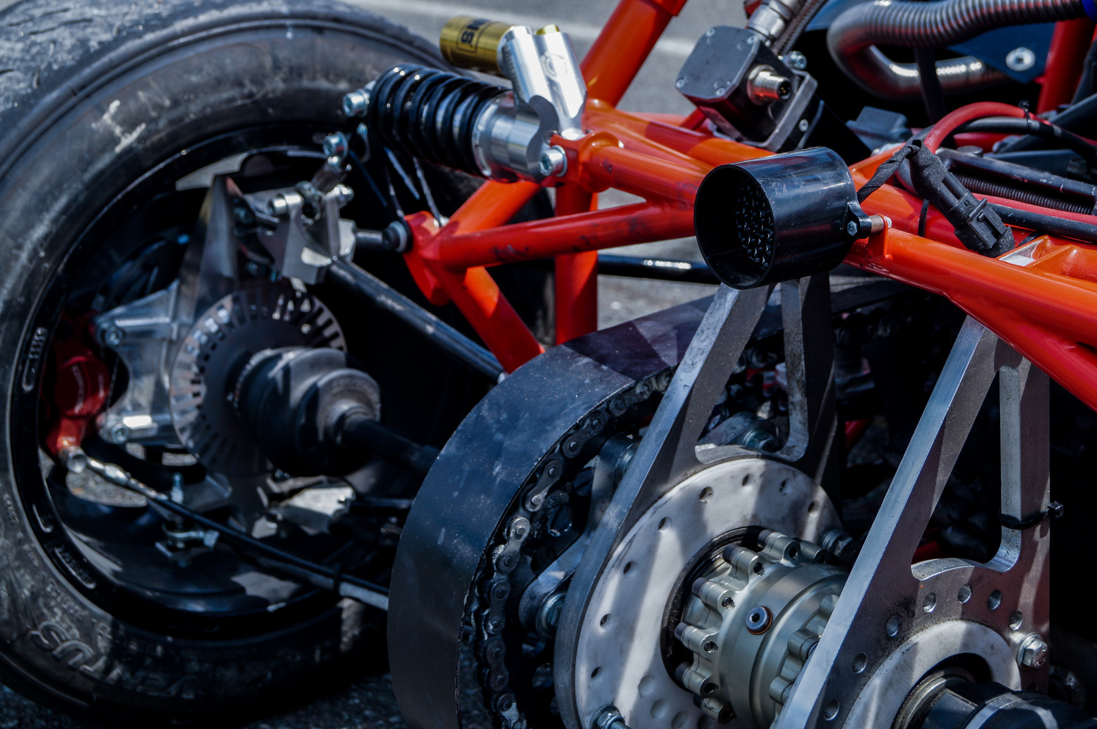
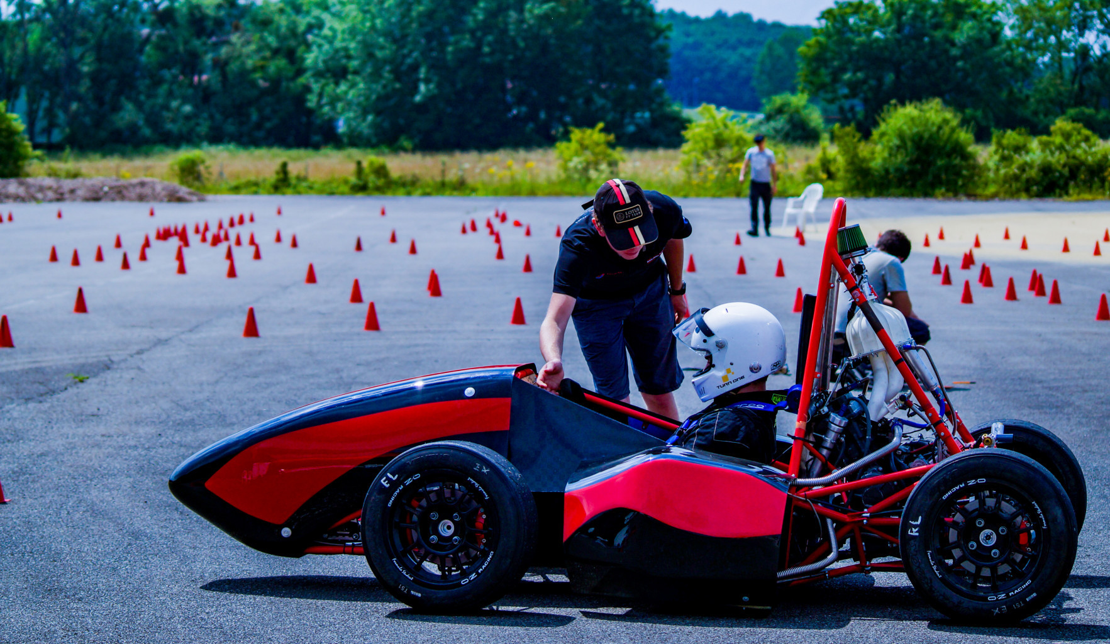
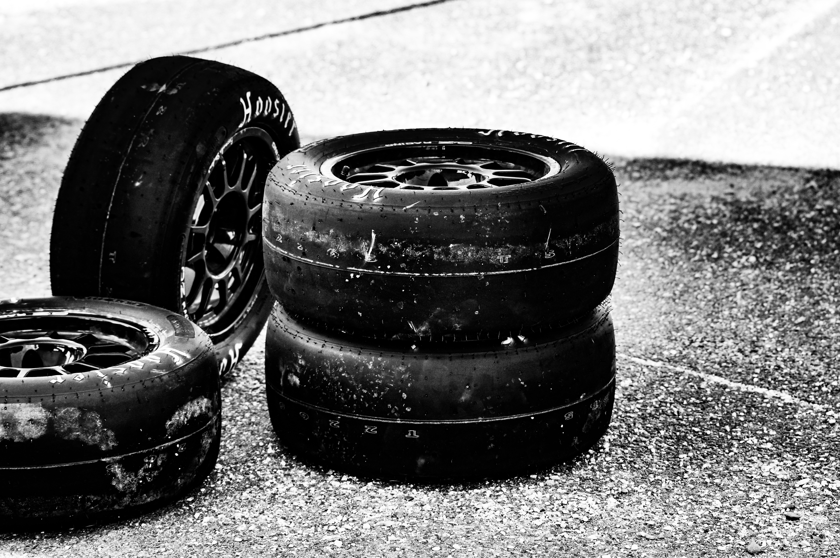
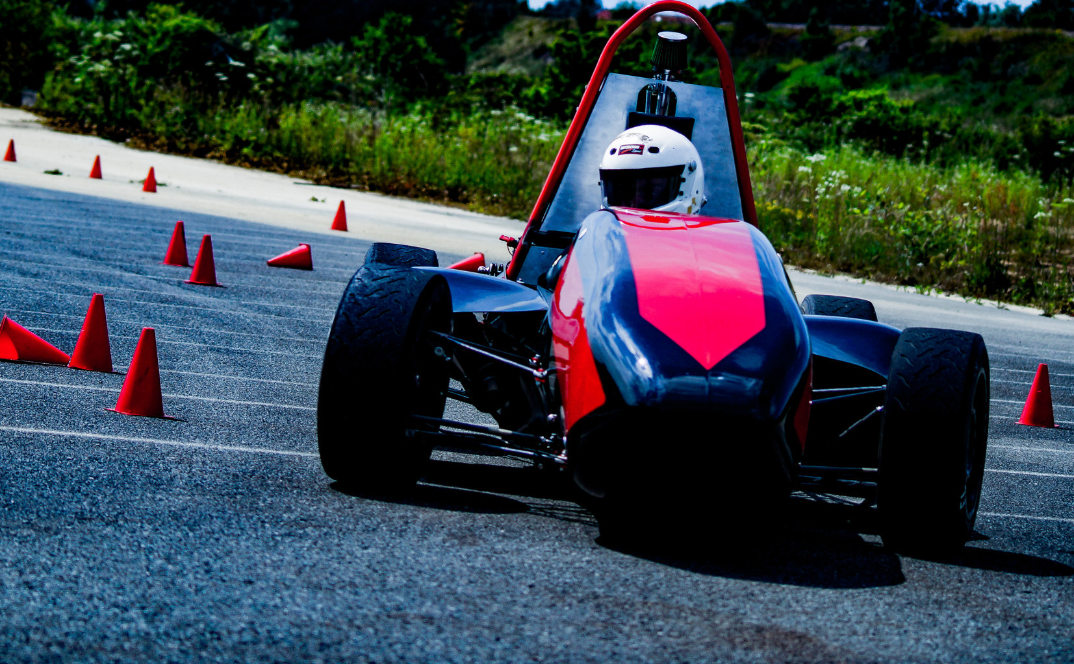
The reference car
12
42 kg steel frame

Slide 13

13
How will we reach our objectives ?
Strategy

Slide 14



Strategy Timeline
September 2018
Inauguration campaign in Lyon and Paris
October 2018
Opening of registrations for 2019’s seminars
January 2019
Launching of the activity
First seminar
2020
New expertise in electric cars. 10 installations around Europe.

Slide 15

2022
More than 90 seminars organized. Partnerships with 20 firms which book a seminar every year.
2024
Internationalization : reaching European market, openings of new assembly garages in Europe
2030
Introducing a new concept ?
Designing and machining parts
Infinite possibilities

Slide 16
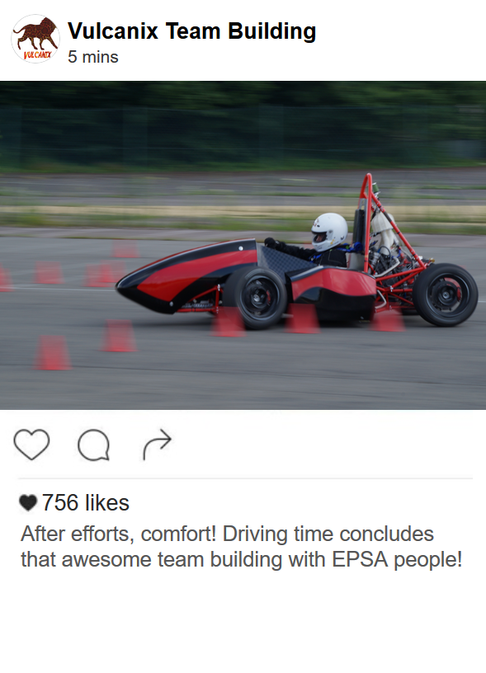
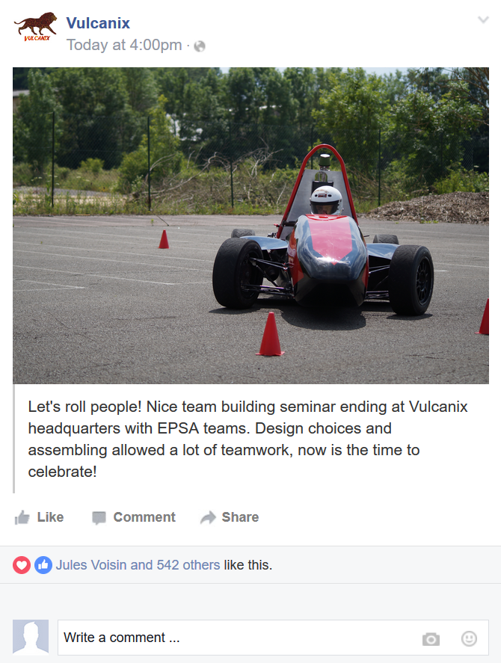
Communication Strategy

Slide 17

Communication Strategy
Targeting our audience
Mail diffusion campaigns
Relevant ads
Featuring in motorsport TV shows, technical reviews read by our target clients
Meeting managers and directors


Slide 18

18
Financial Plan
A strong potential and a bright future

Slide 19

Initial Capital
200,000€
Vulcanix members
Investors
First year Fixed costs
90 €K
110€K
100%
Reactivity
ROI during the second year
2 hypotheses

Slide 20

Financial Analysis
A well-predicted business
5 years horizon
54 % ROCE
Return on investment
Nopat breakeven

Slide 21

21
ANY QUESTION

Slide 22
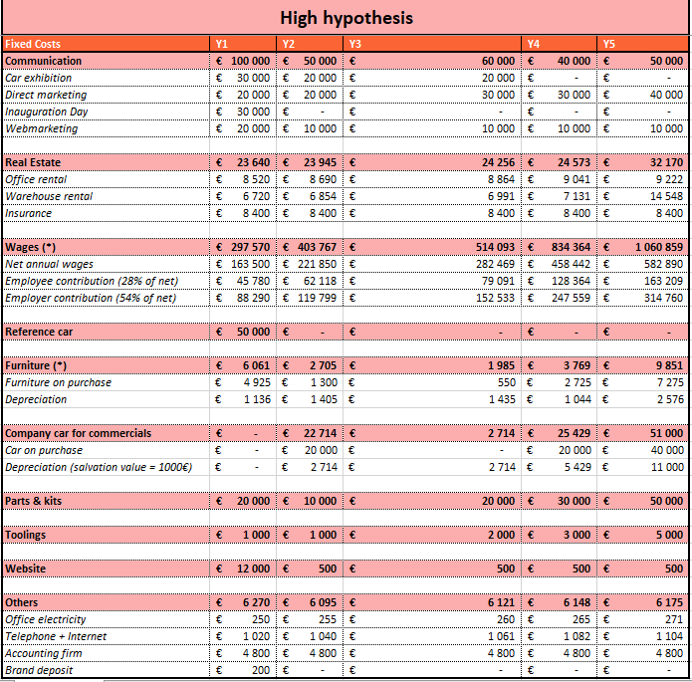
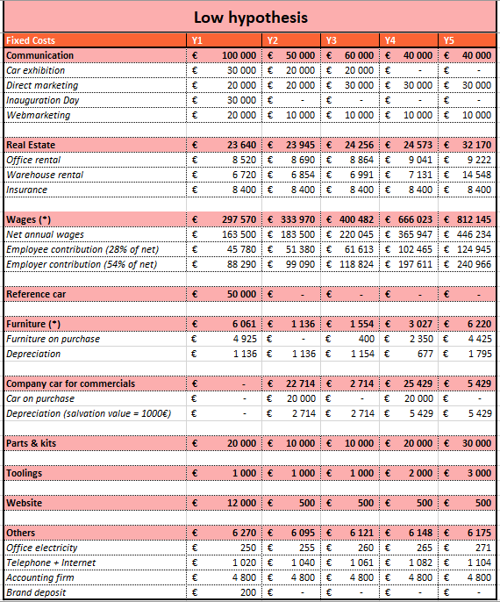
Fixed costs
22

Slide 23
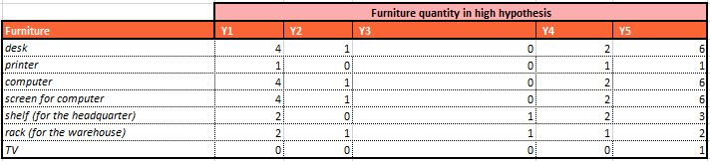
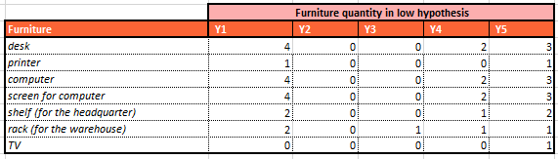
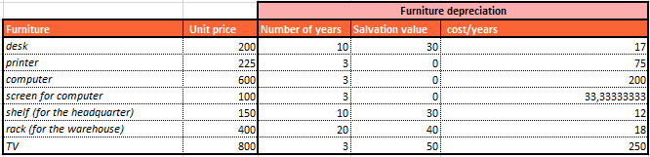
Furniture detail
23

Slide 24
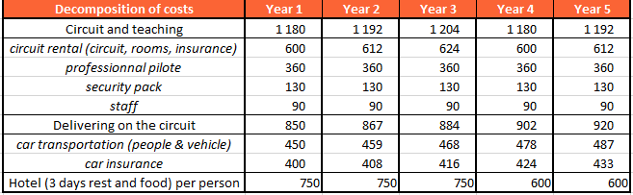
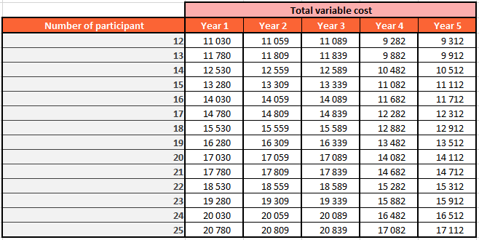
Variable costs
24

Slide 25
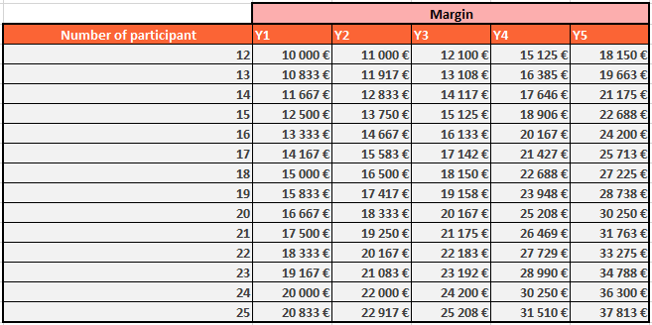

Margin and final price
25

Slide 26
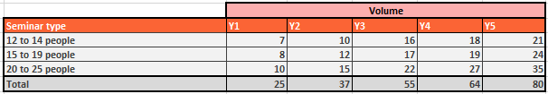
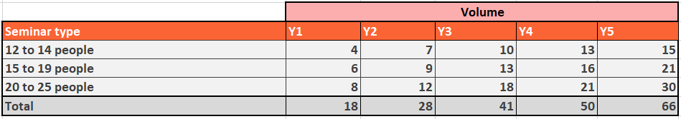
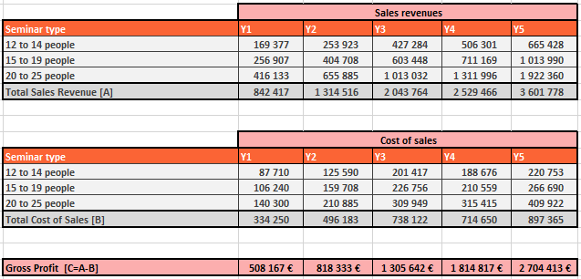
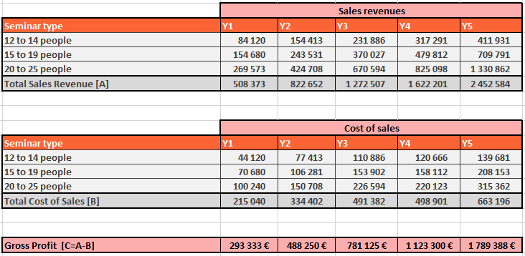
Volume and sales profit
26
High hypothesis
Low hypothesis

Slide 27
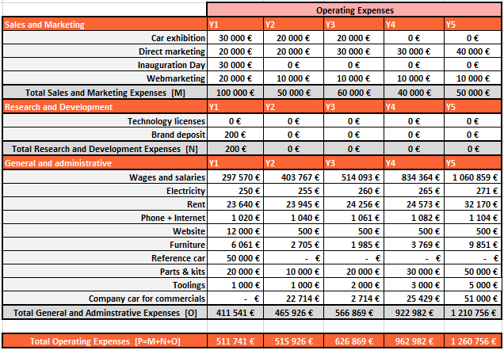
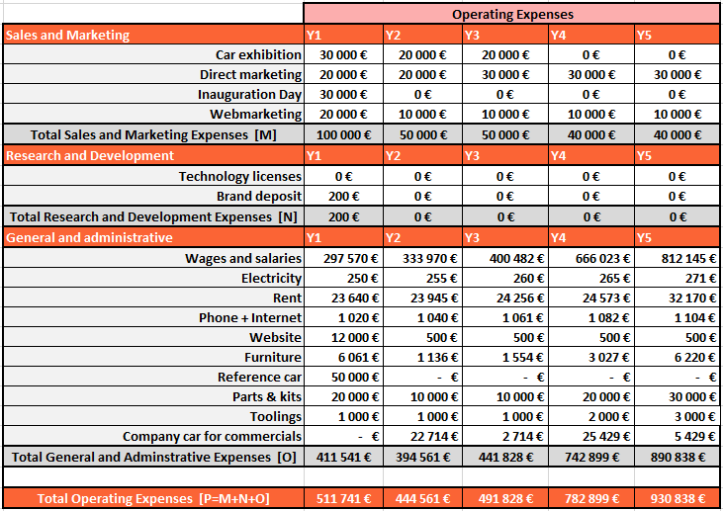
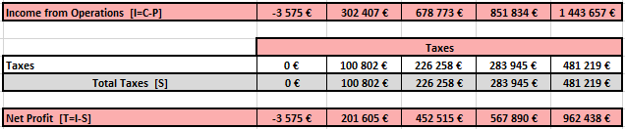
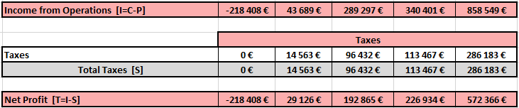
Operating expenses and net profit
27
High hypothesis
Low hypothesis

Slide 28
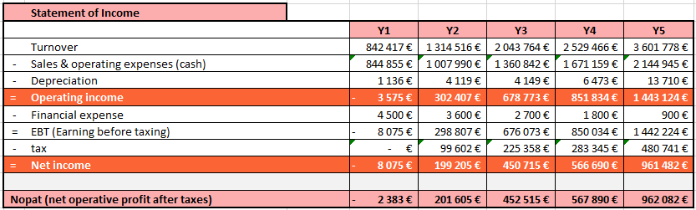
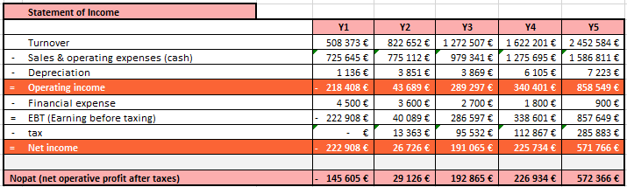
Statement of income
28
HIGH
LOW

Slide 29
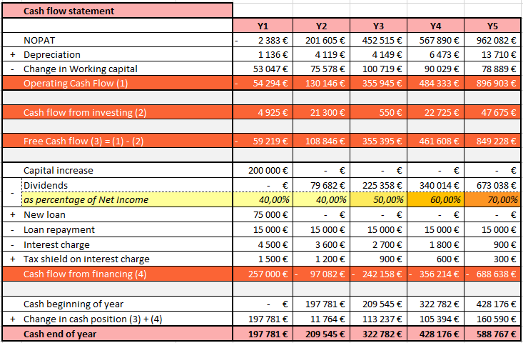
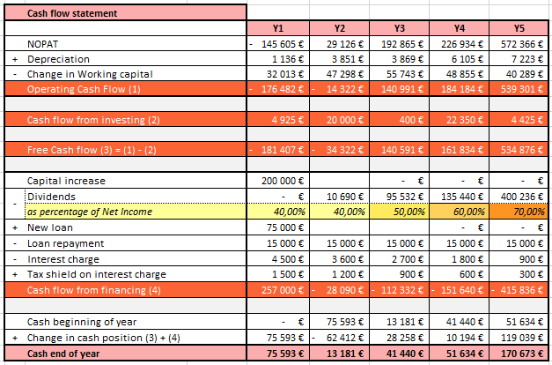
Cash flow statement
29
HIGH
LOW

Slide 30
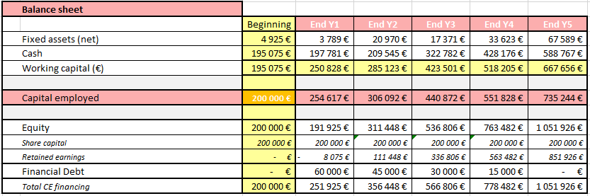
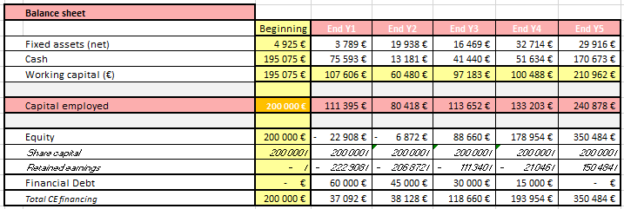
Balance sheet
30
HIGH
LOW

Slide 31
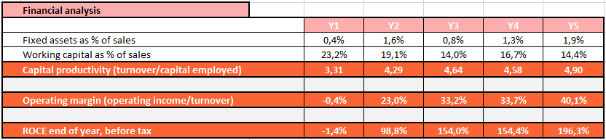
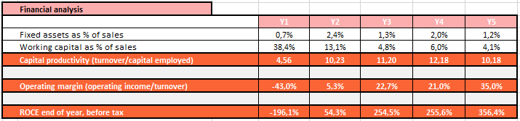
Financial analysis
31
HIGH
LOW

